Slide 1
First Term Success Workshop
Financial Readiness
Notes:
FACILITATOR GUIDE:
With all the benefits the Navy offer, its only right to discuss money management and the resources available. For more in-depth questions/ answers please see the Command Financial Specialist (CFS), check the Fleet and Family Support Center (FFSC) and check with your current bank to see if there any classes offered.

Slide 2
Enabling Objectives
DEFINE the purpose of financial readiness training.
EXPLORE the fundamental components of Basic Pay, Basic Allowance for Housing (BAH), and Basic Allowance for Subsistence (BAS).
IDENTIFY the functions of myPAY.
DEFINE the purpose of Thrift Savings Plan (TSP) and Blended Retirement System (BRS).
IDENTIFY the Servicemembers Civil Relief Act (SCRA).
IDENTIFY the functions of the MyNavy Financial Literacy Mobile Application.
Notes:
FACILITATOR GUIDE:
Review objectives

Slide 3
References
Military Compensation- https://militarypay.defense.gov/Pay/
My Pay webpage- https://mypay.dfas.mil/
Thrift Savings Plan -https://www.tsp.gov/
Servicemembers Civil Relief Act (SCRA) - https://scra.dmdc.osd.mil/scra/#/home
https://www.applocker.navy.mil/
MyNavy HR- https://www.mynavyhr.navy.mil/References/Pay-Benefits/
Notes:
FACILITATOR GUIDE:
Review references

Slide 4
Purpose
Financial readiness of service members and their families is a state in which the successful management of personal financial responsibilities supports a service member’s ability to perform.
With more confidence in their personal finances, service members can better focus on the mission requirements.
Notes:
FACILITATOR GUIDE:
Review definition of financial readiness.

Slide 5
Basic Pay
Basic Pay is the standard amount of compensation and fundamental component of Military pay.
Based on paygrade (rank), and years of service.
  Annual Military basic pay raises are linked to the increase in private-sector wages.
  Pay raises are set by Congress and/or the President.
To view current Basic Pay chart, visit
https://militarypay.defense.gov/Pay/Basic-Pay/Active-Duty-Pay/
Notes:
FACILITATOR GUIDE:
None

Slide 6
Basic Allowance for Housing (BAH)
BAH is an allowance to offset the cost of housing when you do not receive government-provided housing.
Different types of BAH:
  BAH with Dependents
  BAH without Dependents
  Partial BAH
  BAH Reserve Component/Transit BAH
  BAH Differential
Notes:
FACILITATOR GUIDE:
BAH WITH/WITHOUT DEPENDENTS- A member with permanent duty within the 50 United States, who is not furnished government housing, is eligible for Basic Allowance for Housing (BAH), based on the member's dependency status at the permanent duty ZIP Code.
PARTIAL BAH- A member without dependents who is living in government quarters is entitled to a Partial BAH
BAH RESERVE COMPONENT/TRANSIT- BAH RC/T is a non-locality housing allowance for members in particular circumstances, for example, reservists on active duty for 30 or fewer days. It also applies when a member is in transit from selected areas where no prior BAH rate exists (such as overseas).
BAH-DIFFERENTIAL (BAH-DIFF)- BAH-Diff is the housing allowance amount for a member who is assigned to single-type quarters and who is authorized a basic allowance for housing solely by reason of the member's payment of child support.

Slide 7
Basic Allowance for Subsistence (BAS)
BAS is meant to offset costs for a member's meals.
Beginning on January 1, 2002, all enlisted members get full BAS, but pay for their meals (including those provided by the government).
This allowance is not intended to offset the costs of meals for family members.
2024 BAS Rates:
  Officers- $316.98 a month
  Enlisted- $460.25 a month
Notes:
FACILITATOR GUIDE:
https://www.dfas.mil/MilitaryMembers/payentitlements/Pay-Tables/bas/

Slide 8
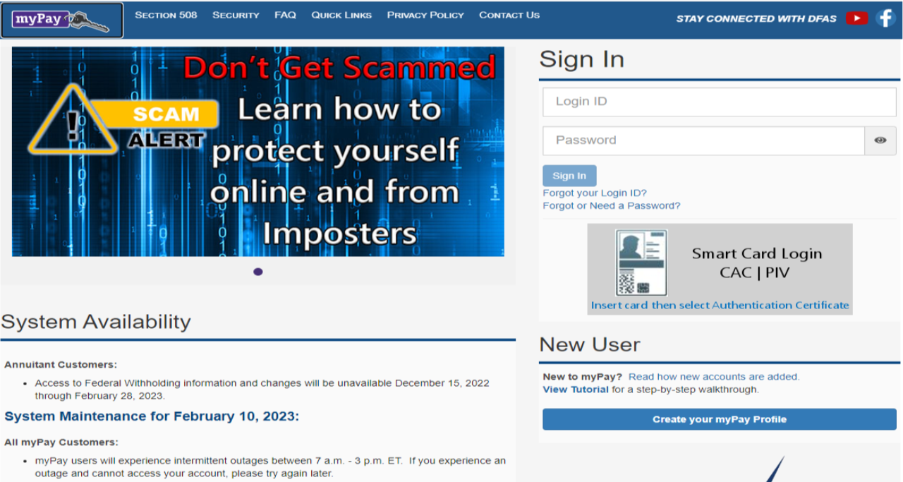
FTSW – MyPay Overview
The first time you access myPay, locate the New User section on the myPay home page and select "Create your myPay Profile." You will need to enter your Social Security Number (SSN) and temporary Password. You will be prompted to create a Login ID and a custom Password. Each time you login after creating your Login ID and Password, you will enter the Login ID and Password on the home page.
https://mypay.dfas.mil/#
With MyPay, you can:
View, print, and save Leave and Earnings Statements (LES)
View and print tax statements
Manage the delivery method for all your statements
and so much more
Notes:
FACILITATOR GUIDE:
MyPay is the Defense Accounting & Finance (DFAS) website where active duty, guard & reserve members can view, print, and save leave and earnings statements (LES), view and print tax statements, manage the delivery method for all your statements, change federal and state tax withholdings, update bank account and electronic fund transfer information, make address changes, view and print travel vouchers, and control Thrift Savings Plan enrollment.

Slide 9
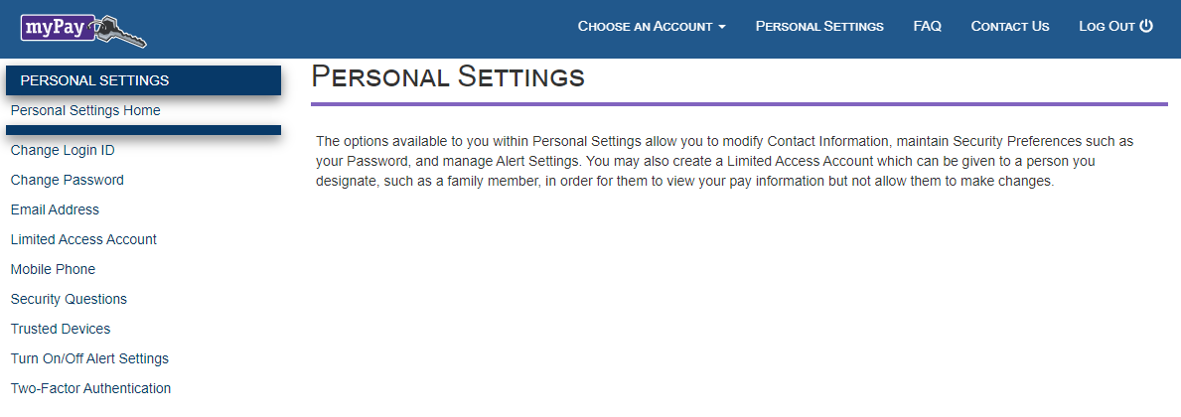
FTSW – MyPay Overview
What is two-factor authentication and how does it work?
Two-factor authentication is a login process that requires something you know (your login ID and password) and something you have (a one-time PIN you receive via email or text). Two-factor authentication requires you to request and input a one-time PIN when you log in to your myPay account with a login ID and password.
Why should you register / update your mobile number with myPay?
myPay will use your mobile number to send two-factor authentication PINs. myPay will also send you text message notifications, in addition to emails, when you take specific actions on your account.
Why should you register / update your email address with myPay?
myPay will use your email address to send two-factor authentication PINs.
Notes:
FACILITATOR GUIDE:
Once you have logged into MyPay it is important to update your personal settings like your email address and phone number.

Slide 10
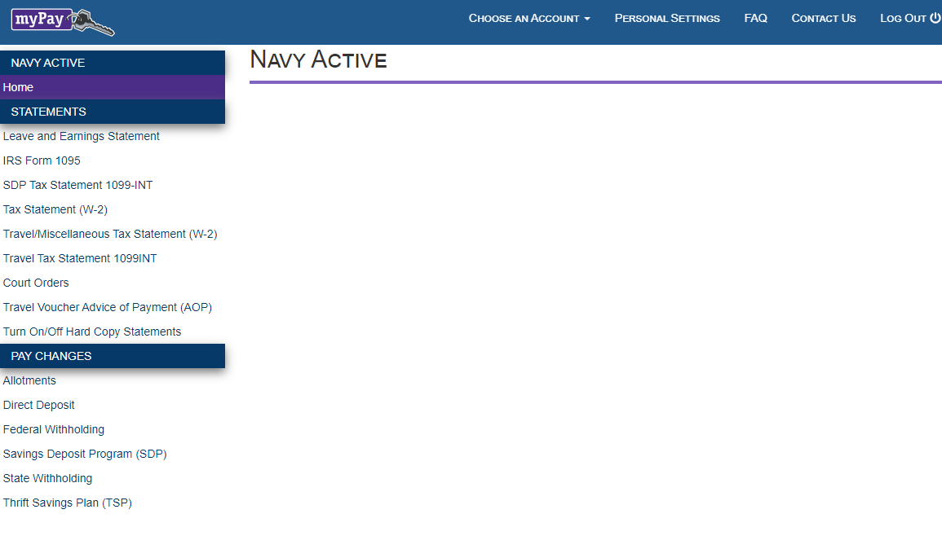
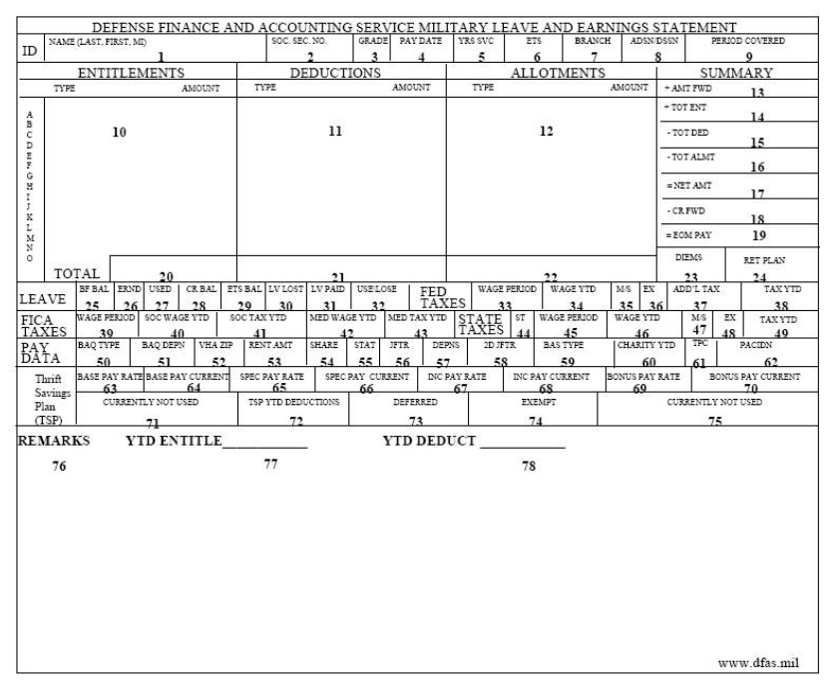
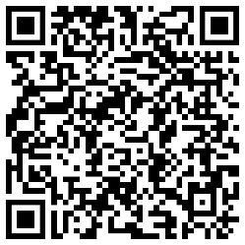
FTSW – MyPay Overview
Review Your Leave And Earnings Statement (LES) To Confirm Accuracy
It is very important and your responsibility to review your LES each pay day to ensure that proper deductions are being withheld.
How to read an Active Duty Navy
Leave and Earnings Statement
This is a guide to help you understand your Leave and Earnings
Statement (LES). The LES is a comprehensive statement of a
member's leave and earnings showing your entitlements,
deductions, allotments, leave information, tax withholding
information, and Thrift Savings Plan (TSP) information.
Notes:
FACILITATOR GUIDE:
Your Leave and Earning Statement (LES). The LES is a comprehensive statement of a member's leave and earnings showing your entitlements, deductions, allotments, leave information, tax withholding information, and Thrift Savings Plan (TSP) information. It is important that you log in monthly to ensure accuracy of your LES. The QR code on the bottom right of the screen is a guide to help you understand your Leave and Earnings Statement
* QR codes will also be provided at the end of the presentation

Slide 11
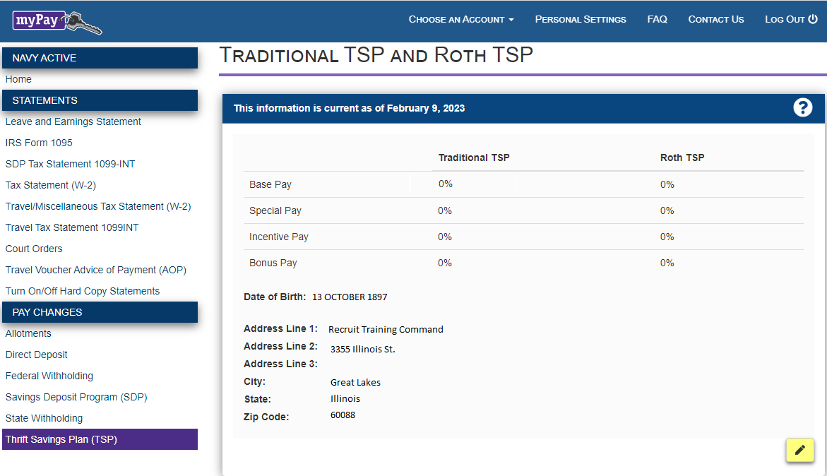
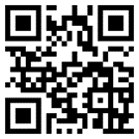
FTSW – MyPay / TSP Overview
Starting your TSP contributions.
The first step in planning participation in TSP is reviewing current pay, bonuses and deductions. This will allow you to determine what percentages of your basic pay, special and incentive pays, and bonuses are available for contribution elections.
Review Your Leave And Earnings Statement (LES) To Confirm Accuracy.
To participate in TSP, you must have elected a minimum of one percent of your basic pay for either traditional or Roth TSP contribution.
Access Your TSP Features
Explore the new TSP experience redesigned to
help you manage your retirement savings with
new features and tools, flexible access to My
Account, additional options for support from
TSP representatives, and more transactions
you can complete smoothly and securely online.
Make sure your current address is up to date.
Once updated your TSP address change will be posted to your military pay account at the next update.
Traditional, Roth, or Both?
You may elect Roth or traditional TSP contributions.
Notes:
FACILITATOR GUIDE:
Your Thrift Savings Plan contributions/allotments start in MyPay. On this tab it is important to update your current address, Once updated your TSP address change will be posted to your military pay account at the next update; and sent to update your Federal Retirement Thrift Investment Board personal account information after the first update of the next full processing month.
Additional Notes:
Address updates will be sent to update your Federal Retirement Thrift Investment Board personal account information.
Traditional TSP contributions are deducted pre-tax; taxes are deferred until you withdraw your contributions. Roth TSP contributions are taken after-tax.
*Remember, traditional and Roth contributions are based on your elections of percentages of pay and not on dollar amounts.

Slide 12
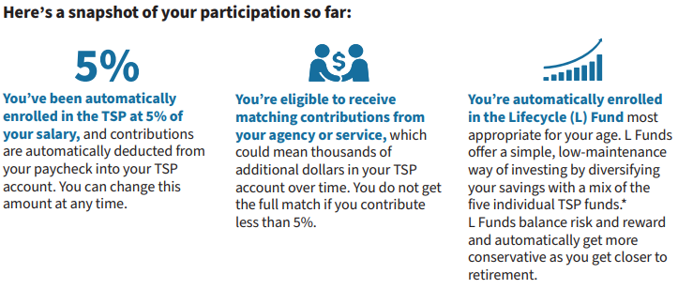
FTSW –TSP overview - www.tsp.gov
You can change your investment election for new money coming into your TSP account and move money among funds. within your account when you log in to My Account.
How to invest?
TSP offers a variety of investment options. You can choose your own mix of investments from a short-term U.S. Treasury security to index funds made of stocks. Or, choose a Lifecycle (L) Funds that uses a professionally determined investment mix designed to deliver a balanced approach to investing.
Set up your login to My Account on tsp.gov and manage your TSP savings efficiently and securely.
When you log in to My Account, you can check your account balance, change your investment choices, submit secure transaction requests, and designate your beneficiaries.
Notes:
FACILITATOR GUIDE:
WELCOME TO THE THRIFT SAVINGS PLAN! – Now that you have updated your address and verified your contributions
You’re now part of the TSP, a long-term retirement savings and investment plan similar to 401(k) plans offered by private companies. Whether you’re new to government or returning to federal service, know that TSP be there to support your financial goals throughout your career, into retirement, and beyond.
Setting up My Account security features and keeping your contact information up to date is essential to protecting your account from fraud and making sure you receive TSP correspondence.

Slide 13
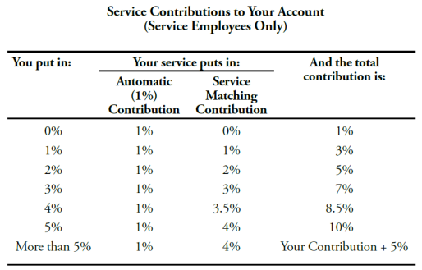
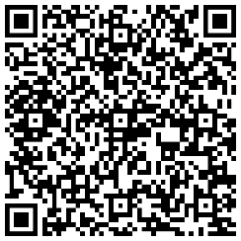
Blended Retirement System
How your contributions matchup
Service Automatic (1%) Contributions.
If you opt into the BRS, your service will begin contributing an amount equal to 1% of your basic pay into your TSP account each month.
Service Matching Contributions.
In addition, if you opt into BRS and elect to contribute a portion of your own pay into your TSP account, your service will match up to an additional 4% of your basic pay.
A quick guide to BRS
militarypay.defense.gov/blendedretirement/
Notes:
FACILITATOR GUIDE:
The Blended Retirement System combines elements of the legacy retirement system with benefits similar to those offered in many civilian 401(k) plans
The BRS has three parts: a Thrift Savings Plan, which is like a civilian 401(k) retirement savings plan; a “continuation pay” bonus after 12 years of service if you choose to reenlist and an annuity payment.
For more information please utilize the QR code on the screen or visit militarypay.defense.gov/blendedretirement/

Slide 14

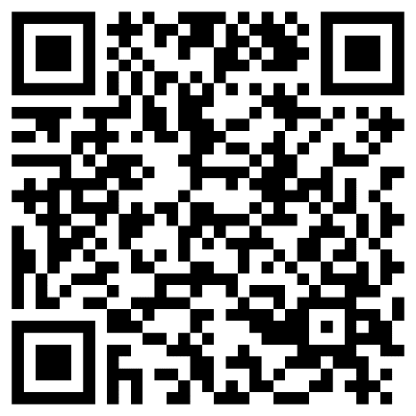
The Servicemembers Civil Relief Act
Benefits and Protections
One of the most notable protections of SCRA is the requirement for creditors to reduce interest rates to 6% on debt incurred prior to entering active duty. This includes individual debts, as well as those held jointly with your spouse.
Termination of residential housing and automobile leases without penalty
Protections against default judgments in civil cases
Protections against foreclosure on your home
Protections against repossession of their property
Know Your Rights
For additional information on SCRA scan the QR code below.
Notes:
FACILITATOR GUIDE:
The Servicemembers Civil Relief Act, or SCRA, supports military personnel by limiting, postponing or suspending a broad range of financial and civil obligations during periods of military service. The SCRA was designed to allow service members to focus solely on their mission of defending our nation. Its protections have specific, situation-based requirements. Speak with a legal representative to discuss how these requirements apply to your individual situation.

Slide 15
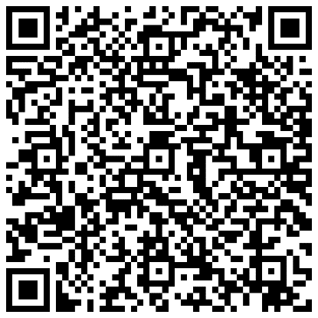
MyNavy Financial Literacy Mobile Application
The MyNavy Financial Literacy application provides personnel with information to achieve their personal financial goals and meet the Navy’s financial literacy education requirements.
The application is divided into the following sections for ease of use:
  Financial Readiness Touchpoint Training Courses (required)
  Financial Literacy Resources
  Blended Retirement System (BRS)
  Future Sailor Financial Readiness Guide
  Debt Destroyer® Workshop
  & Calculators
NOTE: IF YOU COMPLETE THE TOUCHPOINT TRAINING COURSES ON THE APP, AND ENTER YOUR INFORMATION AT THE END OF THE COURSE, IT SHOULD TRANSFER TO YOUR PROFILE AND MARK YOU AS COMPLETING THE REQUIRED “TOUCHPOINT TRAINING COURSES”
Learn more & download the app here:
Notes:
FACILITATOR GUIDE:
https://finred.usalearning.gov/NavyResource

Slide 16
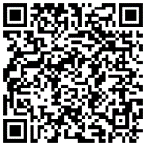

Financial Readiness – Quick Links
How to read your
Leave and Earnings Statement
Access your Thrift Savings Plan Features
A Quick Guide to the Blended Retirement System
Servicemembers Civil Relief Act
MyNavy Financial Literacy Mobile Application
Notes:
FACILITATOR GUIDE:
These QR codes are meant to stay with you, take a pic and keep it for a quick resource.
Point of Contact information for your Command's CFS.

Slide 17
Review and Summary
Financial Readiness
Basic Pay, Basic Allowance for Housing and Basic Allowance for Subsistence (BAH and BAS)
MyPay functions
Thrift Savings Plan (TSP)
Blended Retirement System (BRS)
Servicemembers Civil Relief Act (SCRA)
MyNavy Financial Literacy Mobile Application
Questions?
Notes:
FACILITATOR GUIDE:
How often should you log in and review your LES? Answer: Monthly.
How are Basic Pay, BAH and BAS rates determined? Based on service member pay grade, years of service, dependent status and location where you are assigned.
How do you start, adjust, and stop your TSP allotments? Answer: Under the Thrift Savings Plan tab of myPay.
Under the BRS system, what is the maximum service matching contributions? Answer: 5%
What protections are offered to you under the Servicemembers Civil Relief Act (SCRA)? Multiple Answers possible: Cap 6% interest for prior debt & protections on home/loan default.

